Slide 1

Personal statement toolkit

Slide 2


Skills,
Skills,
Skills.

Slide 3

What does the word
skill mean?

Slide 4

Dictionary definition
‘Skill’
1. Oxford English dictionary: A particular ability or type of ability
2. Cambridge English dictionary: An ability to do an activity or job well, especially because you have practised it
3. Dictionary.com: The ability, coming from one's knowledge, practice, aptitude, etc., to do something well
4. American dictionary: A special ability to do something
A particular ability that you develop through training and experience and that is useful (in a job)

Slide 5

Skills categories
Transferable skills
Personal skills
Knowledge based skills

Slide 6

Skills examples
Personal skills | Transferable skills | Knowledge based
Independence | Communication | Computer programming
Leadership | Teamwork | Playing a musical instrument
Integrity | Organisation | Driving
Patience | Numeracy | Playing a sport
Flexibility | Literacy | Chemical analysis
Compassion | Critical thinking | Speaking a language
Loyalty | Reflection | Graphic design tools
Resilience | Problem solving | First aid
Initiative | Computer literacy | Statistical analysis
Motivation | Attention to detail | Budgeting

Slide 7
Admissible evidence

Slide 8
Dictionary definition
‘evidence’
1. Oxford English dictionary: The available body of facts or information indicating whether a belief or
proposition is true or valid
2. Cambridge English dictionary: Facts, information, documents, etc. that give reason to believe that
something is true
3. Dictionary.com: Ground for belief or disbelief; data on which to base proof or to establish truth or falsehood
4. Collins dictionary: Evidence is anything that you see, experience, read, or are told that
causes you to believe that something is true or has really happened
Evidence will help to back up examples you want to share.

Slide 9
Think far and wide
In person work experience | Blogs & vlogs | Positions of responsibility | Projects or essays | Mentoring
Virtual work experience | Documentaries | Awards | Books | Tutoring
Work shadowing | Podcasts | Challenges | Influencers | Online subject courses
Paid employment | TED Talks | Personal life experiences | Hobbies | Trips or visits
Volunteering | Articles | Work based learning / training | Clubs | Competitions

Slide 10

It’s a jigsaw!
Ultimately, think of completing your personal statement as if it is a jigsaw, built of pieces of evidence.

Slide 11

Browsing history
Go through your online history (or YouTube, social accounts, browser history) for the last two weeks.
Make a note of how many things you have viewed, watched, read or listened to link to a subject or career area you might be thinking about for your future.
How many link directly?
How many link indirectly?
How many are because you've been researching a specific topic in your current studies vs how many are just because you came across it?
Start thinking about the most interesting,
most surprising or new things you've learnt.
If you have none then this is your chance
to start thinking about that evidence!
Notes:
Think outside the box with this - sometimes things might not directly correlate. Perhaps you saw an interesting dress at the Met Gala, researched the designer and this led to you discovering sustainable fashion and environmental studies; perhaps a travel influencer's account made you research a location, you started reading about the cultures of that region and this led you to anthropology!

Slide 12






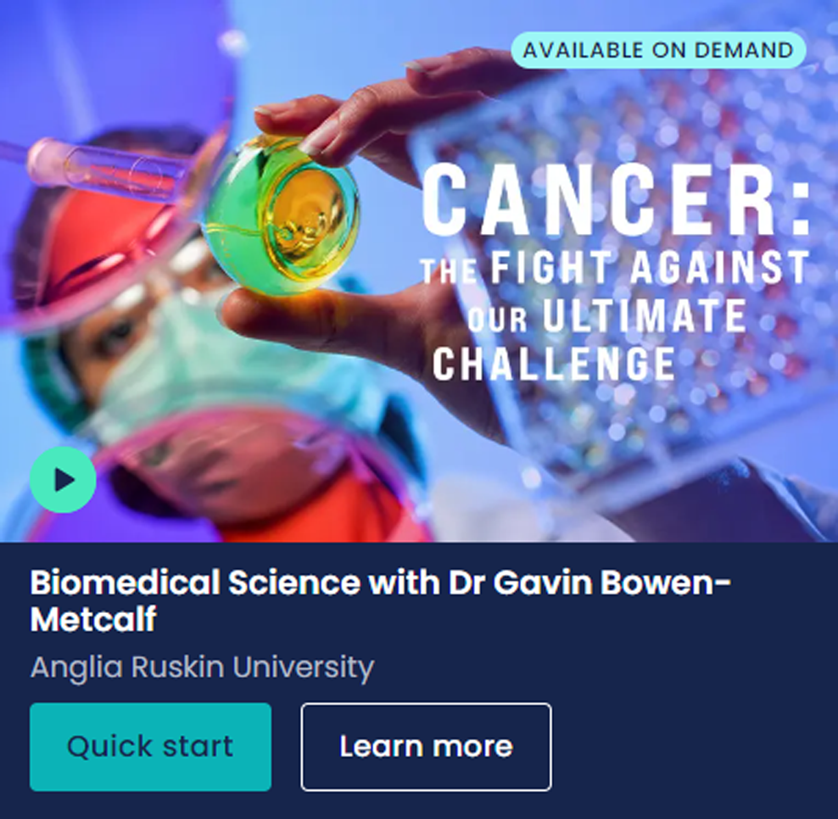

What sort of subject spotlights are available?

Slide 13
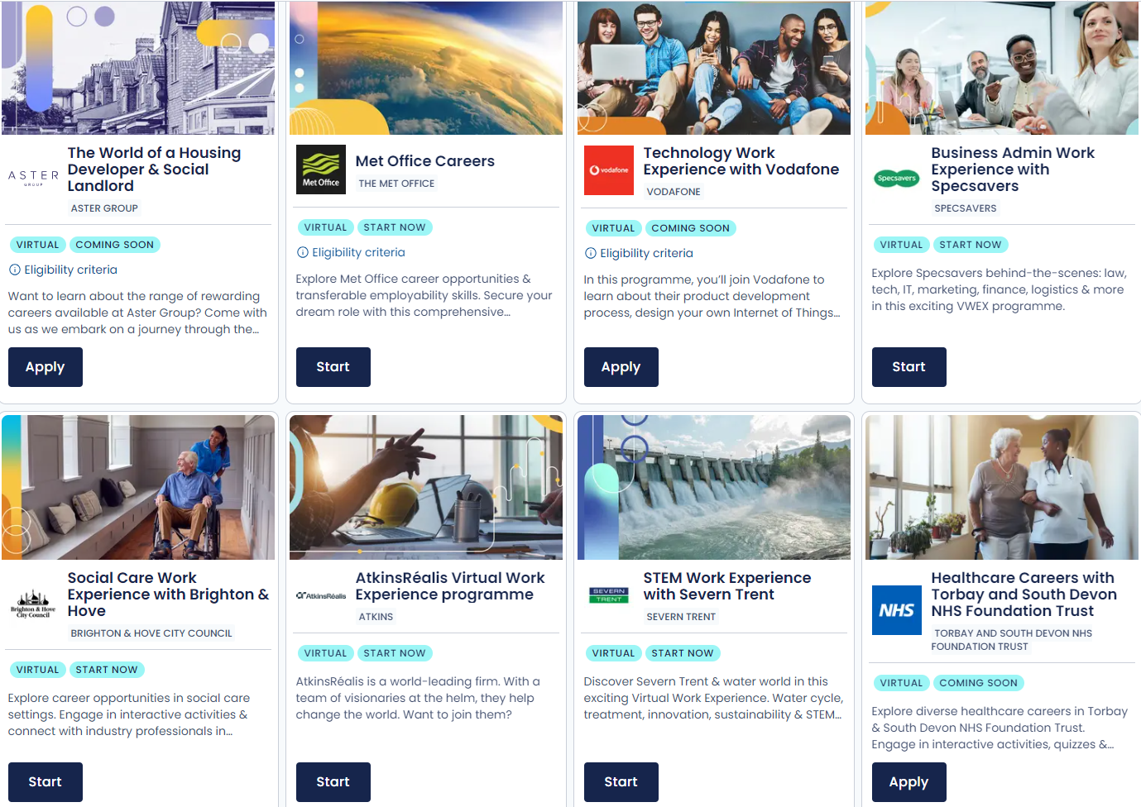
What sort of virtual work experiences are available?
All illustrations designed by Storyset on Freepik.com

Slide 14

Building the foundations

Slide 15

So what?

Slide 16
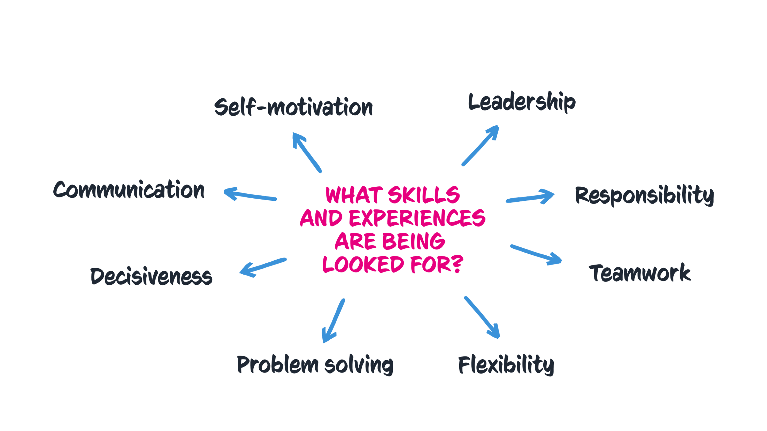
Pick and mix

Slide 17
Pick and mix
?
?
Is everyone looking for the same skills or experiences?
How can you find out what skills or experiences are specifically required?
Why would it help to know?
Do you think admissions tutors might ask ‘So What’?
?
Notes:
Remember this could be very obvious, e.g. for veterinary science you should love animals. But, these skills could also be transferable e.g. law needs the ability to deal with research and attention to detail but also compassion/people skills particularly in areas like family law - perhaps something like mediating between your siblings!

Slide 18
Research what to pick
Read university or college course information on UCAS
Read the course content information on uni or college website
Look at how a course might be assessed
Chat to a student ambassador on Unibuddy who already does the course
Take a subject spotlight session on UCAS
Take a uni or college subject taster session
Ask questions of subject lecturers at an open day
Research job adverts of careers you might be interested in the future
Take the UCAS careers quiz and look at the skills listed for each result
Interview someone already in a career you're interested in

Slide 19

Remember to peel
Point
Make your point
evidence
Back it up with Evidence and examples
explain
Explain how the evidence supports your point
Link
Link it back to the course(s)/subject
All illustrations designed by Storyset on Freepik.com

Slide 20
PERSONAL STATEMENT BLUEPRINT

Slide 21
What ARE THE QUESTIONS?

Slide 22



What are the questions?
“
“
“
Why do you
want to study this course or subject?
How have your qualifications and studies helped you to prepare for this course or subject?
What else have you done to prepare outside of education, and why are these experiences useful?
“
“
“
Notes:
Remember it is one personal statement per application.

Slide 23
Q1: why do you want to study this course or subject?
You’ll want to show evidence of passion, curiosity and interest; this might include:
Motivations for studying this course(s):
Knowledge of this subject area and interests:
Future plans; demonstrate why this course/subject
is a good fit:
Have you been inspired
by a key role model or moment in your life?
Is it a subject you love and want to pursue further?
What is your drive?
How has your path led
you to this course or subject area?
Is there a particular subject area you’ve researched?
Something you can’t wait to learn more about?
What about a book or subject expert doing great things that’s sparked your interest?
Do you already have a particular profession in mind?
How might you use your studies to launch your career?
What’s important to you and your future, and how might
the knowledge gained from
this course(s) help you
achieve this?
Remember these are just some examples, you don’t need to include it all.
The key is to research the course(s) to find out what might be most relevant.
Check out the UCAS personal statement guidance.
Notes:
Remind students that examples don't need to be something 'grand' or academic as the very first starting point if that's not the truth! If the starting point was something 'pop culture', social media or a holiday and they then expanded on this in depth through a variety of methods, then that's great as it shows progression!
Universities and colleges want to see students have done their research so they can be confident this is something they will enjoy and excel in. This is one place to highlight super-curricular activities as evidence of curiosity and interest in the subject outside of the classroom.
Here are some more examples for this section:
Personal life experiences e.g. being a carer, the environment where you grew up or lived, an inspirational friend, colleague or family member, a book you read, a news article or blog/vlog, a YouTube video, a podcast, a show you saw, Subject Spotlights
Understanding of the area and the qualities you might need to succeed in it – research into the course/area

Slide 24
Q2: How have your qualifications and studies helped
you to prepare for this course or subject?
Focus on what’s most recent and relevant to your subject or course(s), examples could include:
How your studies or training relate to chosen course(s) or subject area:
What relevant or transferable skills have you got that make you a great candidate:
Any relevant educational achievements
Are there a couple of subjects that helped you develop a core set of relevant skills required for your chosen course(s)?
Maybe a particular module or project helped you understand where your interests and strengths lie.
Universities and colleges will
see your grades on your application - don’t waste space talking about these.
Focus on your other accomplishments like a competition, holding a position
of responsibility or
representing the
school/college.
This could be your current or previous studies.
This could be from any form of formal education – think school, college, training, or short online courses.
Remember these are just some examples, you don’t need to include it all.
The key is to research the course(s) to find out what might be most relevant.
Check out the UCAS personal statement guidance.
Notes:
This is the chance for students to show evidence of the relevant or transferable skills they've gained from their formal education and highlight their understanding of how this will help them succeed in this subject area.
Here are some more examples for this section:
Specific modules or topics
Essays or projects that explore a particular viewpoint or technique
EPQ – Extended Project Qualification
School, local, or national competitions e.g. UK Maths Trust
Private lessons and qualifications e.g. music, stage school or sports if relevant to the course
Tutoring or mentoring
Online courses leading to a qualification

Slide 25

Q3: what else have you done to prepare outside of
education, and why are these experiences useful?
Examples should be reflective and demonstrate further suitability for your subject or course(s), this could include:
Work experience, employment, or volunteering
Personal life
experiences or responsibilities
Hobbies and any extracurricular or outreach activities:
Achievements
outside of school
or college
In-person or virtual
work experience.
Paid for work or volunteering.
The key thing is reflection on the experiences and
the skills gained relevant to your chosen course(s).
Is there a situation
you’ve personally overcome that has influenced your decision?
Are there personal experiences that have helped you develop essential qualities for
the course?
Think sports, reading, community work,
summer schools.
Any activities outside
of core studies that
help further showcase
why you’d make a
great student.
This could be a position
of responsibility for
local clubs or groups, competitions, or qualifications you’ve attained outside of
the classroom.
Remember these are just some examples, you don’t need to include it all.
The key is to research the course(s) to find out what might be most relevant.
Check out the UCAS personal statement guidance.
Notes:
This is students' chance to talk about any other activities they have undertaken outside of their formal education or personal experiences which further demonstrate their suitability for the course. This section is likely to be highly personal to them and anything they do include should reflect on why they're including it.
Here are some more examples for this section:
Extra and super-curriculars
Volunteering
Personal life experiences e.g. caring for a family member, overcoming a challenge
Young enterprise
Work experience
Job/employment – part-time or full-time
Work-based learning/CPD
Shadowing
Online learning activities e.g. Springpod, MOOCs etc.
Tutoring
Trips and visits (online or in person) e.g. Museums, exhibitions, galleries, sites of historic interest, relevant sites connected to your course e.g. magistrate courts for law etc.
Podcasts, TED talks, documentaries etc.
Duke of Edinburgh/Duke of York awards

Slide 26






Format and structure
Three
sections with question prompts
4,000-total character count split across sections
Minimum character count 350 characters per section
Don’t waste characters listing grades and subjects
Don’t repeat information across
sections

Slide 27
Skills mapping
Using the comparison chart worksheet, start mapping out skills, evidence and examples across your 5 choices.
The chart has columns for:
UCAS Choice (Course) – the course and university or college name.
Key Transferable Skills (e.g., communication, problem-solving, teamwork).
Subject-Specific Skills (or knowledge) (e.g., research skills, technical knowledge like Excel or graphics programmes )
These may be skills you already have or those you will develop on the course.
Personal Evidence (e.g. real-life experiences or achievements)

Slide 28
What can I use to help me?
There are lots of ways you can research the details of the course(s) / subject you're looking to apply to:
Remember requirements may differ for each university or college, as well
as depending heavily on the course.
It is important to look in detail at the course, modules, and assessment details as this will give you clues as to what exactly is being looked for in a potential student for that course.
So, this research on your chosen area of study is vital before you start writing your personal statement.
The course description is key as this’ll help you with what
to include and give you a good idea of what they are looking for.
Did you attend an open day? What did you learn about the course there?
What can you find on the university or college website?

Slide 29
Your comparison chart
UCAS CHOICE (COURSE) | KEY TRANSFERABLE SKILLS | SUBJECT SPECIFIC SKILLS (OR KNOWLEDGE) | PERSONAL EVIDENCE OR EXAMPLES

Slide 30
Your comparison chart – example only
UCAS CHOICE (COURSE) | KEY TRANSFERABLE SKILLS | SUBJECT SPECIFIC KEY SKILLS (OR KNOWLEDGE) | PERSONAL EVIDENCE OR EXAMPLES
Business XXX University | Research strengths, analytical skills, quantitative skill, communication, leadership. | Corporate governance, marketing, new technologies. | What examples and evidence do you have to demonstrate these skills e.g. Online course: Society & Environment: What Are The Ethical Responsibilities Of A Business? Personal project written about What responsibility do businesses have to their consumers? Budgeting my money from part time job salary. Delivering a presentation in final unit studies.
Business management The University of xxx | Leadership, teamwork, communication. | The global environment, new technologies, entrepreneurial innovation, marketing
Business management with marketing XXX College | Presenting, budgeting and evaluation. | Legal, ethical and efficient practices, supporting innovation. Environmental and technological influences.
Business management XXX University | Problem solving, communication with others, project management, analytics. | Agile delivery, digital marketing principles, suitability in business management.
Business management with marketing XXX University | Group work and problem solving., teamwork. Independence. | Marketing data analysis, digital software usage, and creative content strategies.

Slide 31
Ideas under construction
Take some time to reflect before you start your first draft. Look through your comparison chart and take some time to:
Don’t worry about making this perfect; it’s about checking
you fully understand the course and have specifics to refer to in your personal statement.
Whether you know what you’re applying to or still considering your options, the more prep you do now the easier it will be to write.
Highlight the common skills that appear across multiple choices.
Rank your evidence and examples that are MOST relevant
to the course(s) you're thinking of applying to.
Make sure you look at the UCAS personal statement guides for ideas on what to include in each question.

Slide 32


Using AI in your personal statement
AI features can support in researching and reviewing your personal statement document. Make sure you read UCAS guidance on using AI when writing your personal statement.
There are a few ways AI tools can assist you.
Brainstorm some ideas about topics that are relevant to your chosen subject, which you can then relate to your own experiences and opinions. Or you could ask it to list skills that are relevant to the course you're applying for, allowing you to think about your own talents and how to convey them.
Help with structure you may want some suggestions of structuring your personal statement.
Checking readability for example ways to rephrase certain sentences to make them more concise, while maintaining their meaning.
Notes:
Remember the more people that use tools like ChatGPT to write personal statements, rather than as a research, structuring, and ideas tool, the more the model will use these examples for future personal statements. These will then be more detectable through similarity software. It's not worth the risk, so stick to using AI tools to help prompt your personal statement journey, rather than doing it for you (and more than likely doing it inaccurately!).
Remind students that when they complete their application, they must declare that their personal statement hasn't been copied or provided from another source, including artificial intelligence software.
As part of UCAS’s responsibility to applicants and universities and colleges, the UCAS Verification Team run checks to detect fraudulent applications and patterns of similarity in personal statements. Read our guide to fraud and verification and similarity.
If UCAS software detects elements of a personal statement that are similar to others, the universities or colleges it is intended for may be notified.

Slide 33

AI Dos and don’ts
DO
DON’T
Do use AI carefully and make sure you understand how the data you input is being used. Read our guidance.
Do fact check everything that AI tools suggest. They do get things wrong!
Do double check if the universities or colleges you are applying to have specific guidance around using AI tools.
Don’t copy and paste from AI tools and use as your final text.
Don’t forget that AI can only state facts but cannot reflect your own skills, experiences and thoughts in your voice, which is what universities are looking for!
Don’t forget to check how AI tools might use your data!
Remember UCAS run checks to
detect similarity in personal statements.
Notes:
Remind students that when they complete their application, they must declare that their personal statement hasn't been copied or provided from another source, including artificial intelligence software.
Remember the more people that use tools like ChatGPT to write personal statements, rather than as a research, structuring, and ideas tool, the more the model will use these examples for future personal statements. These will then be more detectable through similarity software. It's not worth the risk, so stick to using AI tools to help prompt your personal statement journey, rather than doing it for you (and more than likely doing it inaccurately!).
As part of UCAS’s responsibility to applicants and universities and colleges, the UCAS Verification Team run checks to detect fraudulent applications and patterns of similarity in personal statements. Read our guide to fraud and verification and similarity.
If UCAS software detects elements of a personal statement that are similar to others, the universities or colleges it is intended for may be notified.

Slide 34
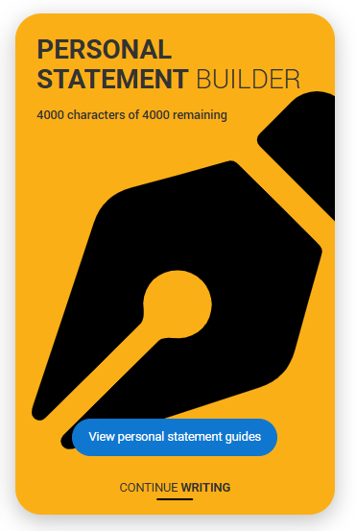
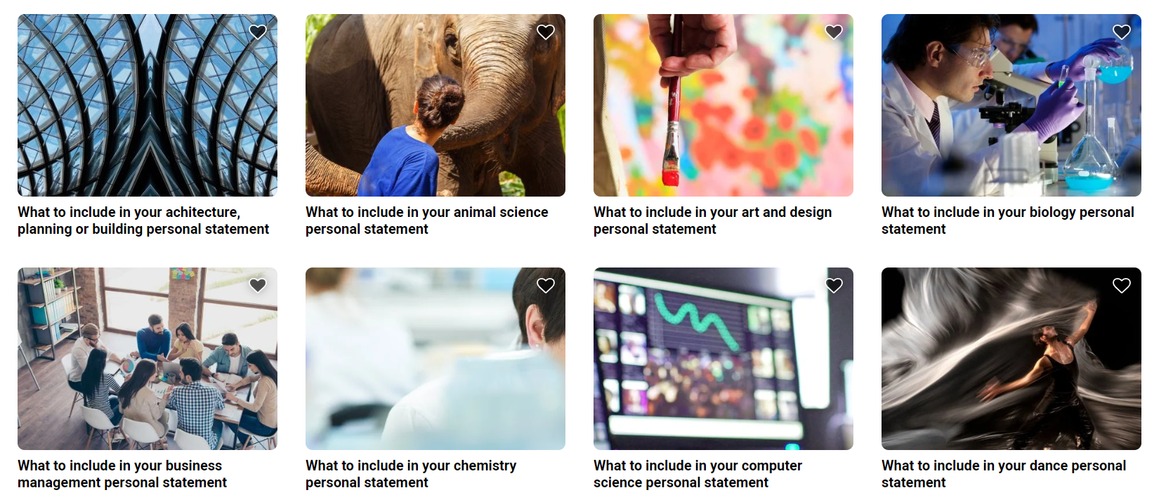
READY, SET, DRAFT – YOUR SUPPORT
www.ucas.com/applying/applying-university/writing-your-personal-statement/2026-personal-statement-guides
Notes:
www.ucas.com/applying/applying-university/writing-your-personal-statement/2026-personal-statement-guides

Slide 35

Reviewing your ucas personal statement

Slide 36

reviewing your personal statement
  Before submitting a first or final draft of your personal statement, you should aim to review this and check it is suitable for submission.
  You can review this yourself or ask a friend/relative to provide you with some feedback and guidance on strengths and any areas of development.
  It is usually beneficial for your work to be peer-assessed. A fresh pair of eyes Ꙭ can really help spot things you may not have noticed.

Slide 37

Self-assessing your format and structure
When reviewing your draft personal statement, a good place to start is by checking the format and structure. This should be done before asking anyone else to check over your personal statement.
Read through your finalised personal statement and check that you have:
No more than 4000 characters across all three question prompts. ✓
A minimum of 350 characters per question prompt. ✓
Not wasted any characters listing information that can be found on my UCAS application such as grades and subjects. ✓
Not repeated any information, evidence or examples across the three questions. ✓
Remember that universities and colleges view the three questions as a whole.

Slide 38

Proofreading your personal statement
It’s important to proofread.
Tips for proofreading.
Ask a friend/relative to:
Checking for spelling, punctuation and grammatical errors is an important review task.
But it can be tricky to find errors in your own work.
You can really benefit from somebody else reading through your personal statement and providing feedback too.
Take a break before proofreading. It’s harder to spot errors if you do it immediately after completing your work.
Use the spellcheck function on your computer but make sure the dictionary is set to English (United Kingdom).
Read your work aloud as it can make it easier to spot errors and sentences that just don’t sound right.
Read through your work a few times and focus on looking for one type of error at a time (spelling, punctuation and capital letters, sentence structures).
Provide you with detailed feedback so that it is easy for you to identify where amendments are needed.
Offer any further suggestions for improving your work.

Slide 39
Using AI in your personal statement
AI features can support in researching and reviewing your personal statement document. Make sure you read UCAS guidance on using AI when writing your personal statement.
There are a few ways AI tools can assist you.
Brainstorm some ideas about topics that are relevant to your chosen subject, which you can then relate to your own experiences and opinions. Or you could ask it to list skills that are relevant to the course you're applying for, allowing you to think about your own talents and how to convey them.
Help with structure you may want some suggestions of structuring your personal statement.
Checking readability for example ways to rephrase certain sentences to make them more concise, while maintaining their meaning.
Notes:
Remember the more people that use tools like ChatGPT to write personal statements, rather than as a research, structuring, and ideas tool, the more the model will use these examples for future personal statements. These will then be more detectable through similarity software. It's not worth the risk, so stick to using AI tools to help prompt your personal statement journey, rather than doing it for you (and more than likely doing it inaccurately!).
Remind students that when they complete their application, they must declare that their personal statement hasn't been copied or provided from another source, including artificial intelligence software.
As part of UCAS’s responsibility to applicants and universities and colleges, the UCAS Verification Team run checks to detect fraudulent applications and patterns of similarity in personal statements. Read our guide to fraud and verification and similarity.
If UCAS software detects elements of a personal statement that are similar to others, the universities or colleges it is intended for may be notified.

Slide 40
AI Dos and don’ts
DO
DON’T
Do use AI carefully and make sure you understand how the data you input is being used. Read our guidance.
Do fact check everything that AI tools suggest. They do get things wrong!
Do double check if the universities or colleges you are applying to have specific guidance around using AI tools.
Don’t copy and paste from AI tools and use as your final text.
Don’t forget that AI can only state facts but cannot reflect your own skills, experiences and thoughts in your voice, which is what universities are looking for!
Don’t forget to check how AI tools might use your data!
Remember UCAS run checks to
detect similarity in personal statements.
Notes:
Remind students that when they complete their application, they must declare that their personal statement hasn't been copied or provided from another source, including artificial intelligence software.
Remember the more people that use tools like ChatGPT to write personal statements, rather than as a research, structuring, and ideas tool, the more the model will use these examples for future personal statements. These will then be more detectable through similarity software. It's not worth the risk, so stick to using AI tools to help prompt your personal statement journey, rather than doing it for you (and more than likely doing it inaccurately!).
As part of UCAS’s responsibility to applicants and universities and colleges, the UCAS Verification Team run checks to detect fraudulent applications and patterns of similarity in personal statements. Read our guide to fraud and verification and similarity.
If UCAS software detects elements of a personal statement that are similar to others, the universities or colleges it is intended for may be notified.

Slide 41
Questions to ask your reviewer
Can you find evidence that I have…
Have I used PEEL effectively when writing by…
Have I…
Shown my curiosity, knowledge and passion?
Evidenced relevant skills and my potential?
Communicated a genuine interest and a desire to learn more?
Linked my academic, extra-curricular and other experiences to my chosen area(s)
of study?
Used relevant examples throughout my personal statement?
Making a clear point?
Backing it up with clear evidence and examples?
Clearly explaining how evidence supports my points?
Making links back to the course(s)?

Slide 42

Also remember...
Get feedback from one person at a time. Make any relevant changes before asking for further feedback.
Don’t submit a copy to a teacher/tutor without having proofread it first.
To only share your personal statement with people you trust.

